Slide 1
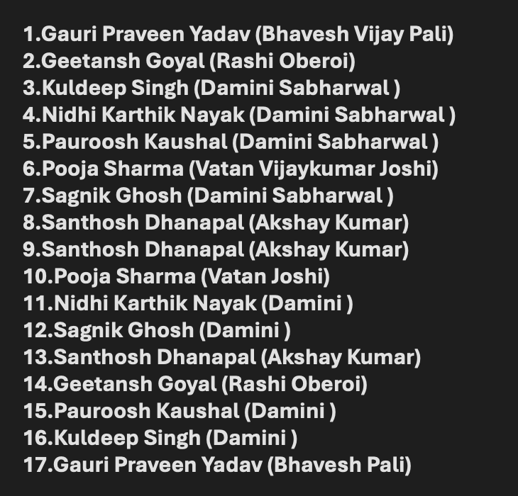
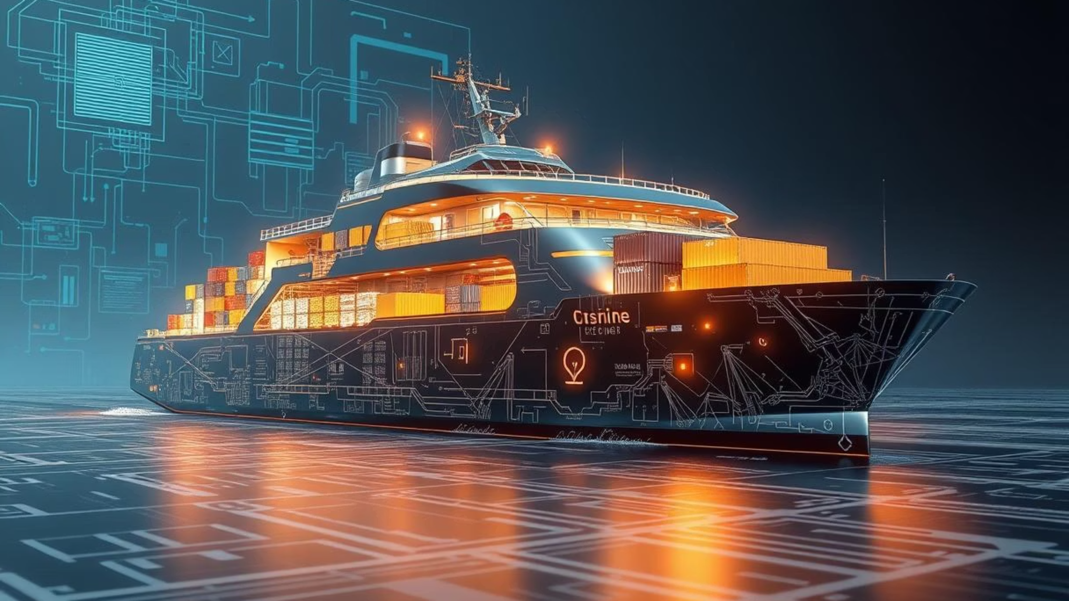
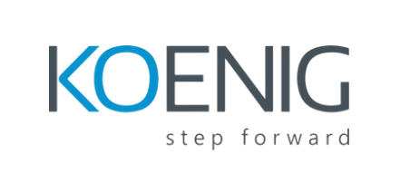
Building Better Docker Images
Practices for Production-Ready Containers
Processed by PPT Studio
Processed by PPT Studio
Notes:
**Focus on Best Practices:** Briefly introduce the slide's focus on practical techniques for creating robust, production-ready Docker images. **Mention "Building Better" and "Production-Ready."**

Slide 2
Agenda: Optimising Your Docker Workflow
In this session, we'll cover key strategies for building Docker images that are efficient, secure, and ready for production environments. We'll explore:
1
Efficiency & Size
2
Security Best Practices
3
Maintainability & Consistency
Crafting lean images for faster deployments and reduced resource consumption.
Minimising attack surfaces and safeguarding your applications.
Ensuring reliable builds across development and CI/CD pipelines.
Processed by PPT Studio
Processed by PPT Studio
Notes:
**Slide Note:**
"This slide outlines the agenda for our session: Optimising Your Docker Workflow. We'll dive into three key areas: 1) achieving efficiency through lean image creation, impacting deployment speed and resource usage; 2) bolstering security with best practices to minimize vulnerabilities; and 3) establishing maintainability and consistency for reliable builds across your development lifecycle and CI/CD pipelines. Each point will be explored in detail in the following sections."

Slide 3
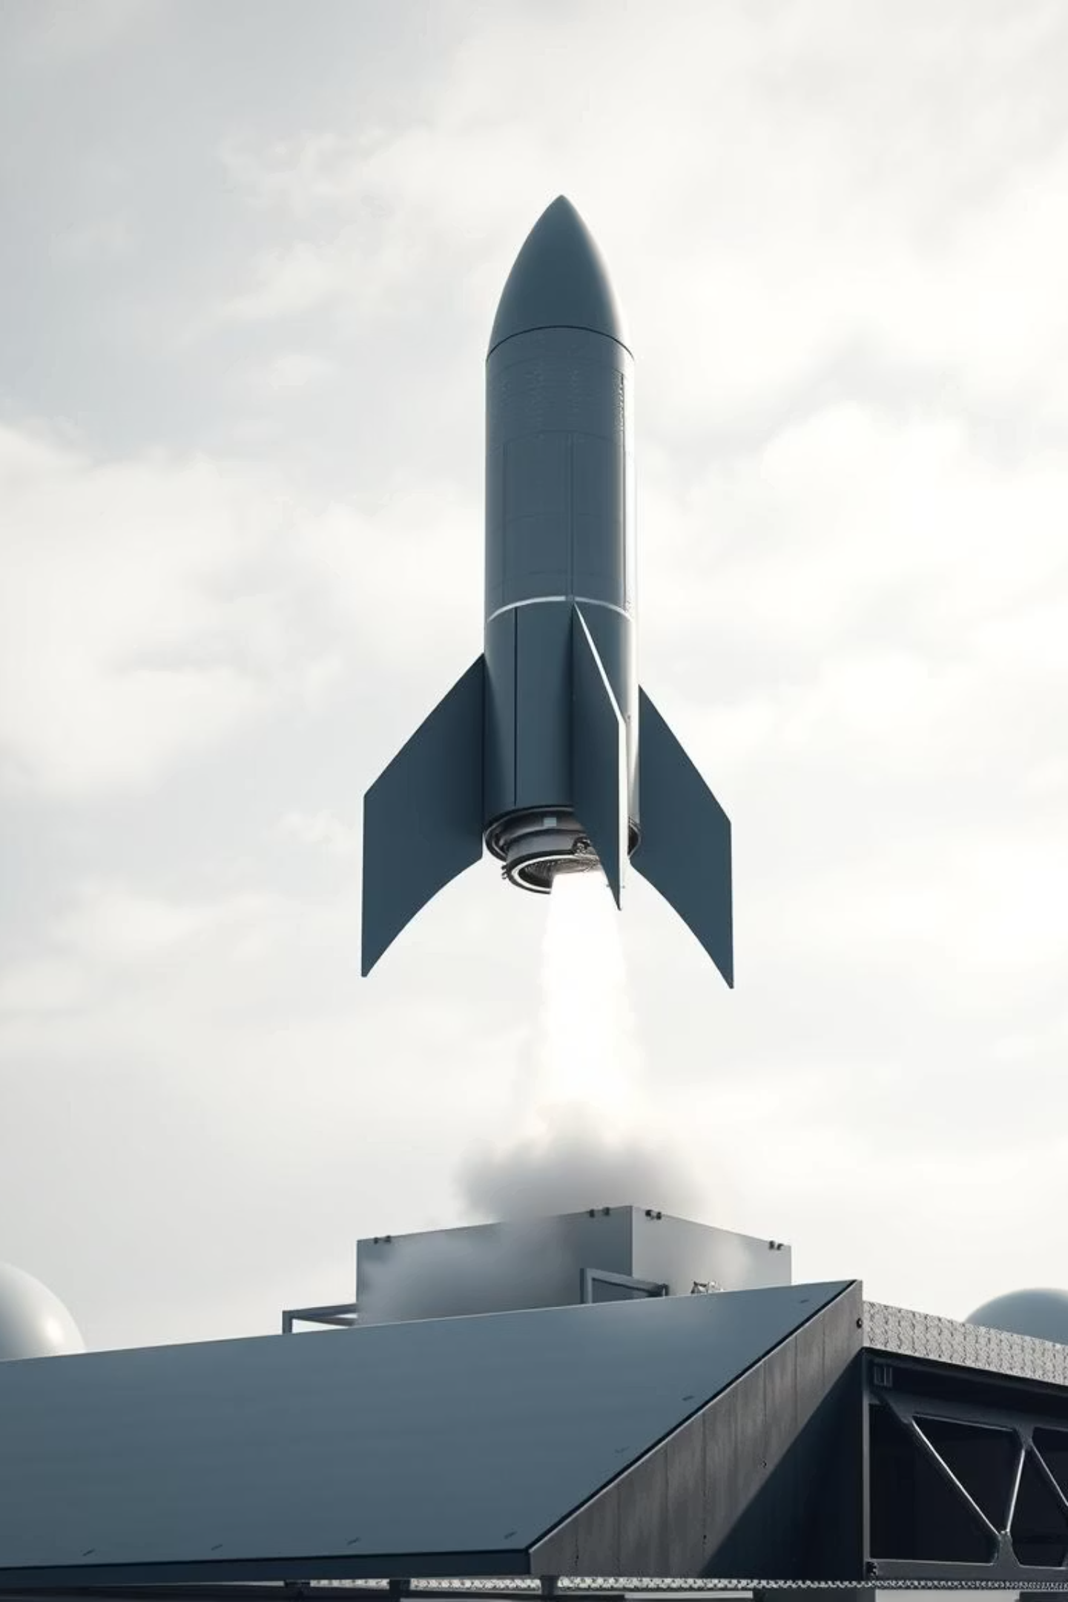
Start Lean: Minimal Base Images
The foundation of an efficient Docker image is its base. Choosing a minimal base image dramatically reduces size and potential vulnerabilities.
1
2
Alpine Linux
Debian Slim
Extremely small, designed for minimal footprints. Ideal for many applications.
A stripped-down version of Debian, offering a good balance between size and compatibility.
3
Language-Specific Variants
Many language runtimes offer slim or alpine variants (e.g., node:alpine, python:slim).
Processed by PPT Studio
Processed by PPT Studio
Notes:
**Speaker Note:**
"This slide emphasizes the importance of lean base images in Docker. We're discussing building efficient Docker images. Start with a minimal base image like Alpine Linux for extreme small size and reduced attack surface, or Debian Slim for better compatibility. Always check for language-specific slim or Alpine variants like `node:alpine` or `python:slim` to further minimize your image size. Choosing the right base is foundational to a lightweight and secure container."

Slide 4



Multi-Stage Builds: The Golden Rule
Multi-stage builds are critical for creating small, secure, and production-ready images by separating build-time dependencies from runtime necessities.
Build Stage
Final Stage
Result
Compile your application, run tests, and generate artefacts using all necessary tools.
Copy only the compiled artefacts to a minimal base image, leaving build tools behind.
Significantly smaller image, reduced attack surface, and faster deployments.
Processed by PPT Studio
Processed by PPT Studio
Notes:
**Speaker Note:**
"This slide highlights the 'golden rule' of multi-stage builds. We use them to optimize our Docker images. First, the 'Build Stage' is where we compile everything, using all the necessary SDKs and tools. Then, in the 'Final Stage,' we copy *only* the resulting artifacts into a lean base image. This gives us smaller images, fewer security vulnerabilities, and quicker deployment times. This is a key practice for efficient and secure containerization."

Slide 5

Optimise with .dockerignore & Layer Minimisation
These two practices work hand-in-hand to ensure your Docker images are as lean and performant as possible.
Leverage .dockerignore
Minimise Layers
Combine related RUN instructions using &&.
Exclude development files (e.g., .git, node_modules, local temp files).
Each RUN, COPY, FROM command creates a new layer.
Speeds up build context transfer.
Fewer layers result in smaller images and better cache utilisation.
Prevents sensitive or unnecessary files from being added.
Processed by PPT Studio
Processed by PPT Studio
Notes:
Okay, here's a concise and professional speaker note for that slide:
**Speaker Note:**
"This slide highlights two crucial optimizations for Docker image builds: `.dockerignore` and Layer Minimization. Explain that these are key to creating lean and performant images. First, emphasise the importance of `.dockerignore` to exclude unnecessary files like development dependencies and sensitive data. This speeds up the build process and improves security. Then, discuss layer minimization, highlighting the impact of each `RUN`, `COPY` and `FROM` instruction. Encourage the audience to combine related instructions with `&&` to reduce the number of layers and improve image size and caching efficiency. "

Slide 6
Dependency Management & Cleanup
Consistent and clean images rely on disciplined dependency management and thorough post-installation cleanup.
Pin Dependency Versions
Clean Up After Installation
Avoid Unnecessary Tools
Always specify exact versions for packages and dependencies. This ensures reproducible builds across all environments.
Immediately remove package caches, temporary files, and build artefacts within the same RUN instruction to prevent creating unnecessary layers.
Only install what's absolutely required for the application's runtime. Use multi-stage builds to separate build-time tools.
Processed by PPT Studio
Processed by PPT Studio
Notes:
**Speaker Note:**
"This slide emphasizes the importance of dependency management for lean, consistent images. We'll discuss three key strategies: First, **always pin dependency versions** to guarantee reproducible builds and avoid unexpected issues. Second, **clean up after installation within the same `RUN` instruction** to minimize image size. Finally, **avoid installing unnecessary tools** in the final image, leveraging multi-stage builds to handle build-time dependencies. Implementing these practices will significantly improve the security, speed, and reliability of your container images."

Slide 7
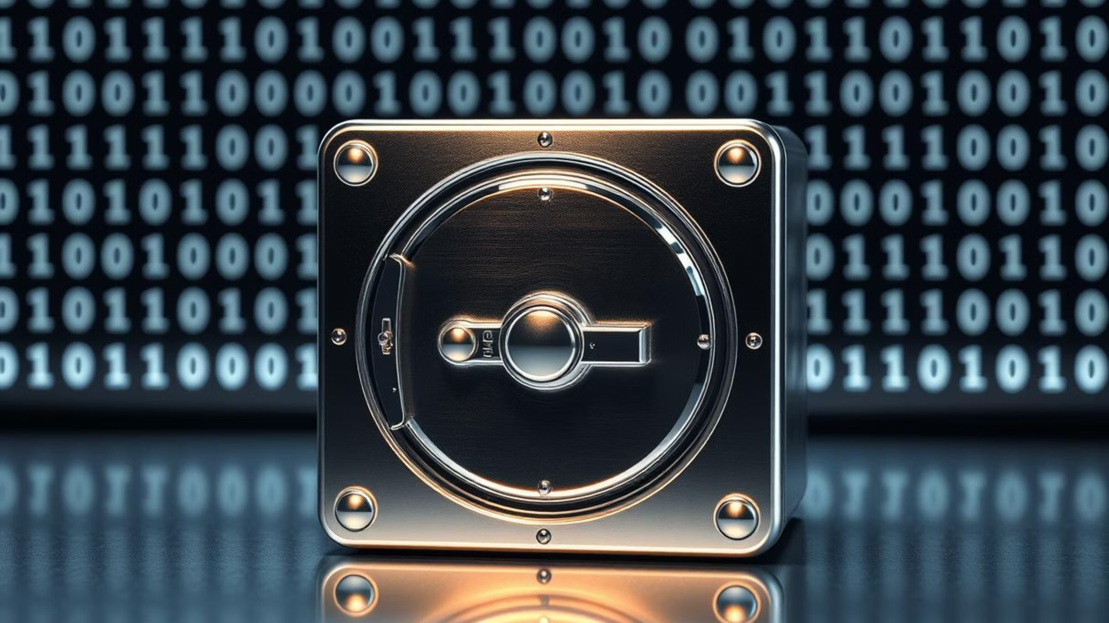
Security First: Beyond the Basics
Building secure images isn't just about reducing size; it's about minimising risk.
Processed by PPT Studio
Processed by PPT Studio
Notes:
* **Title Emphasis:** "Security First" - This slide reinforces our commitment to security as a priority.
* **Expand on Image Security:** Briefly explain that image security encompasses more than just smaller sizes. We're focusing on minimizing the attack surface and potential vulnerabilities.
* **Transition Cue:** This is a good point to mention what specific security measures will be discussed in the following slides (e.g., vulnerability scanning, secrets management, hardening).
* **(Optional - If Relevant):** Briefly mention the tools or processes used for achieving security, if it sets up a future topic.
* **Ignore/Remove "Processed by PPT Studio":** This is irrelevant to the audience and should be removed from the actual slide (if possible). It's likely a watermark or artifact from a presentation tool.

Slide 8
Enhanced Security: User and Command Best Practices
Protecting your containers from potential exploits requires careful attention to user permissions and command usage within the Dockerfile.
Run as Non-Root User
Prefer COPY over ADD
Always switch to a non-root user using the USER directive.
COPY is simpler and more predictable, only copying local files.
Limits potential damage if a container is compromised.
ADD has additional features (URL download, tar extraction) that can introduce security risks or unexpected behaviour if not carefully used.
Example: RUN adduser --system appuser, then USER appuser.
Processed by PPT Studio
Processed by PPT Studio
Notes:
**Slide Title: Enhanced Security: User & Command Best Practices**
* **(Main Point):** Emphasize the importance of secure container configuration. We're focusing on **limiting the attack surface** by configuring user permissions and command usage.
* **(User Permissions):** Highlight the necessity of running containers as non-root users. Explain that doing so reduces the potential damage if a container is compromised. Briefly mention the example of using `adduser` and `USER`.
* **(Command Usage):** Advise preferring `COPY` over `ADD` due to its predictability and reduced risk. Explain that `ADD`'s extra functionality can create vulnerabilities or unexpected behavior. Keep it concise and avoid getting bogged down in technical details.
* **(Optional):** Briefly mention that these practices are crucial for compliance and building a robust security posture.

Slide 9
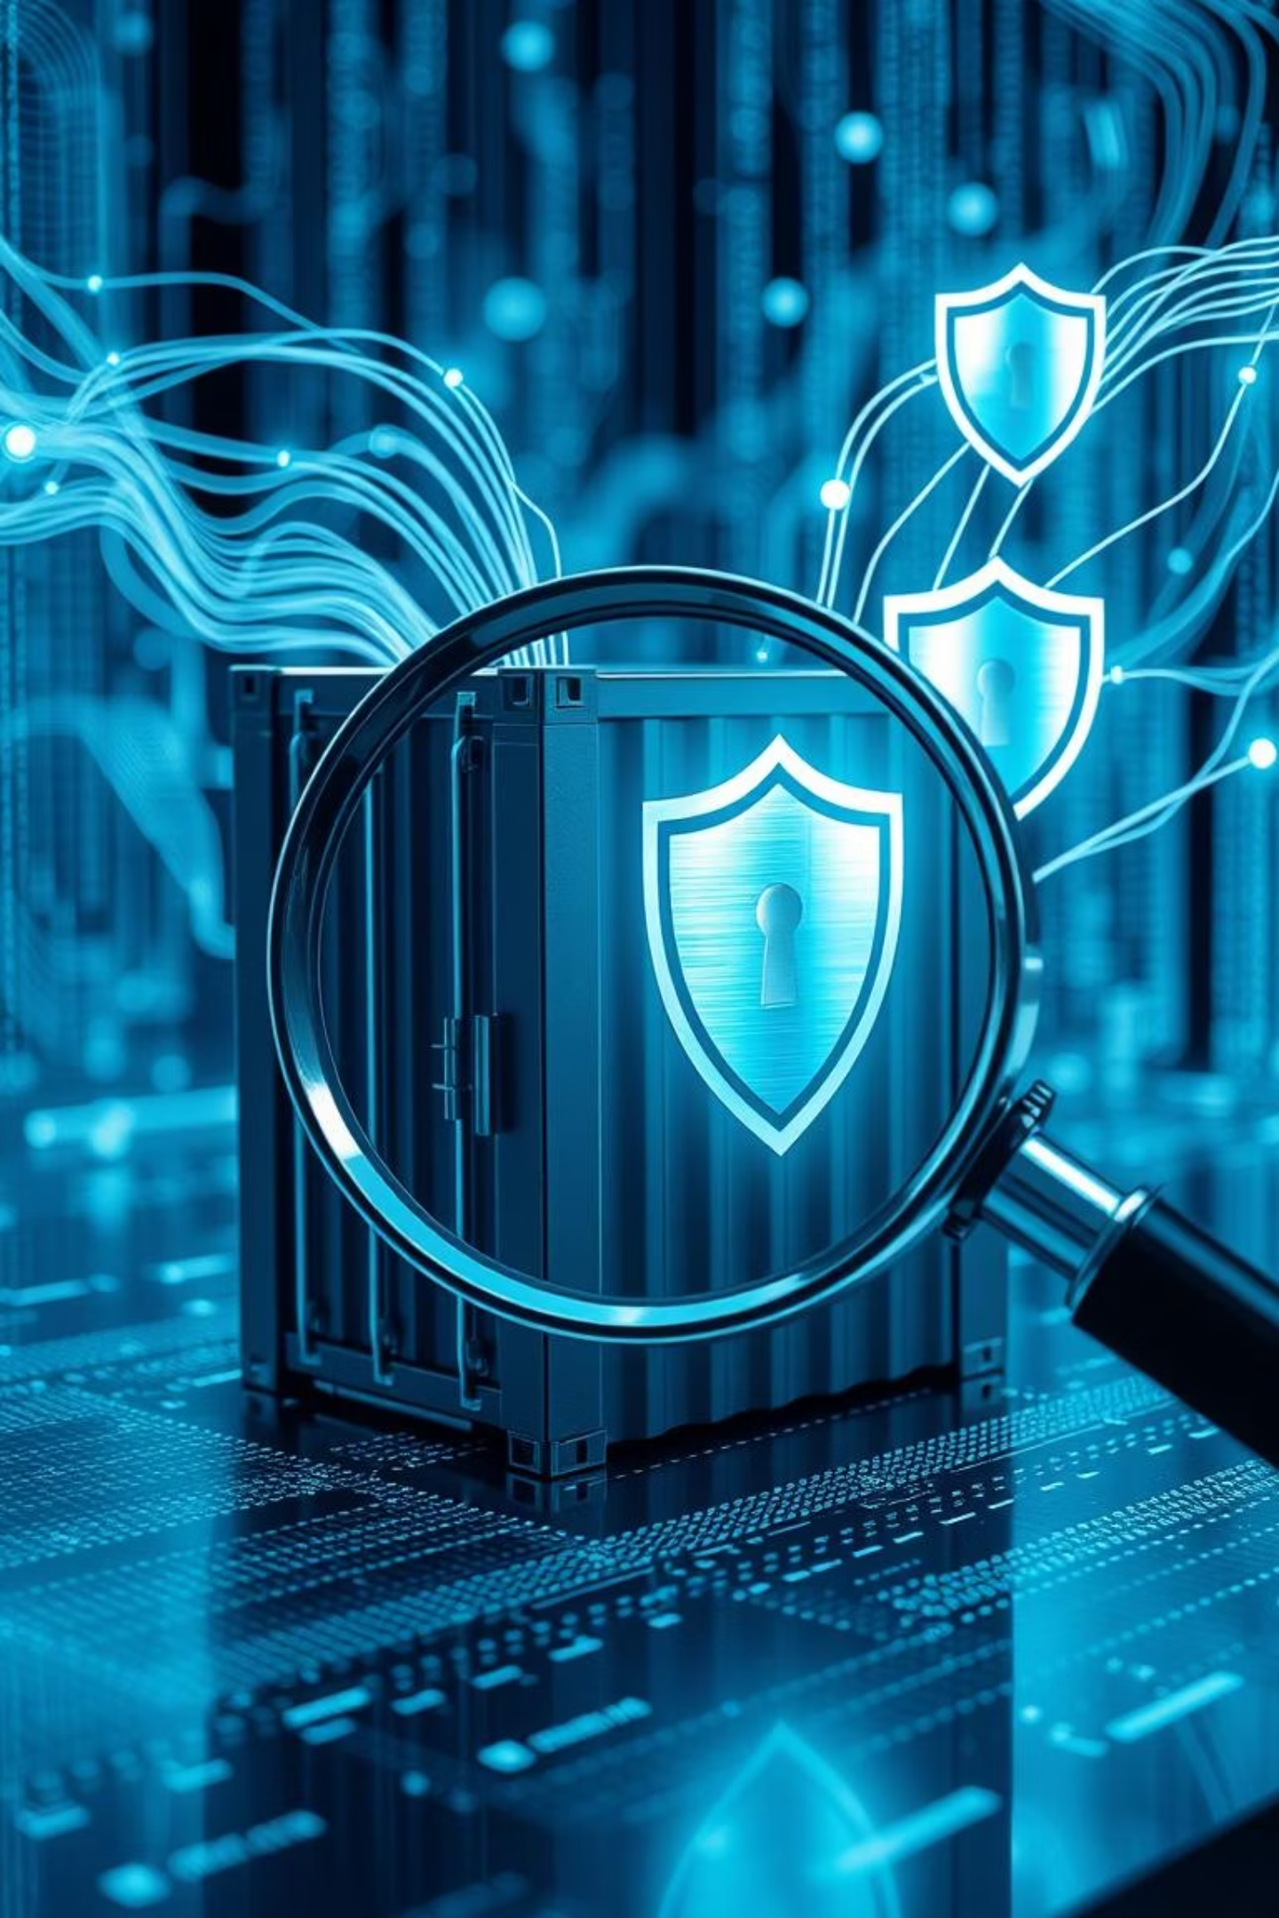
Image Scanning & CI/CD Integration
Proactive security scanning is essential for identifying and mitigating vulnerabilities throughout your development lifecycle.
Automate Scans
1
Integrate tools like Trivy, Docker Scout, or Clair into your CI/CD pipelines.
Catch Issues Early
2
Identify known vulnerabilities in dependencies and base images before deployment.
Continuous Monitoring
3
Regularly scan images even after deployment to detect newly discovered threats.
Processed by PPT Studio
Processed by PPT Studio
Notes:
**Slide Title: Image Scanning & CI/CD Integration**
**Note:**
This slide emphasizes the importance of proactive security through image scanning. Briefly explain how automated scanning within CI/CD pipelines (using tools like Trivy, Docker Scout, or Clair) enables early vulnerability detection in dependencies and base images. Highlight the need for continuous monitoring of deployed images to catch newly discovered threats. This integrates security seamlessly into the DevOps process.

Slide 10



Key Takeaways & Next Steps
Optimise Early
Secure by Design
Integrate & Automate
Prioritise lean images from the start with minimal bases and multi-stage builds.
Implement non-root users, careful dependency management, and regular scanning.
Make image building and security a seamless part of your CI/CD workflow.
These practices are the bedrock for resilient, performant, and secure Dockerised applications.
Processed by PPT Studio
Processed by PPT Studio
Notes:
Okay, here's a concise and professional speaker note option for that slide:
**Speaker Note:**
"This slide summarizes our key takeaways. Remember to **optimize Dockerfiles early** for smaller, faster images. **Prioritize security by design** with non-root users and robust dependency management. Finally, **integrate security and building into your existing CI/CD pipeline for automation**. Adopting these practices will significantly improve the resilience, performance, and security of your Dockerized applications. Let's now delve into [mention the next topic or section you'll be moving on to]."

